Slide 1
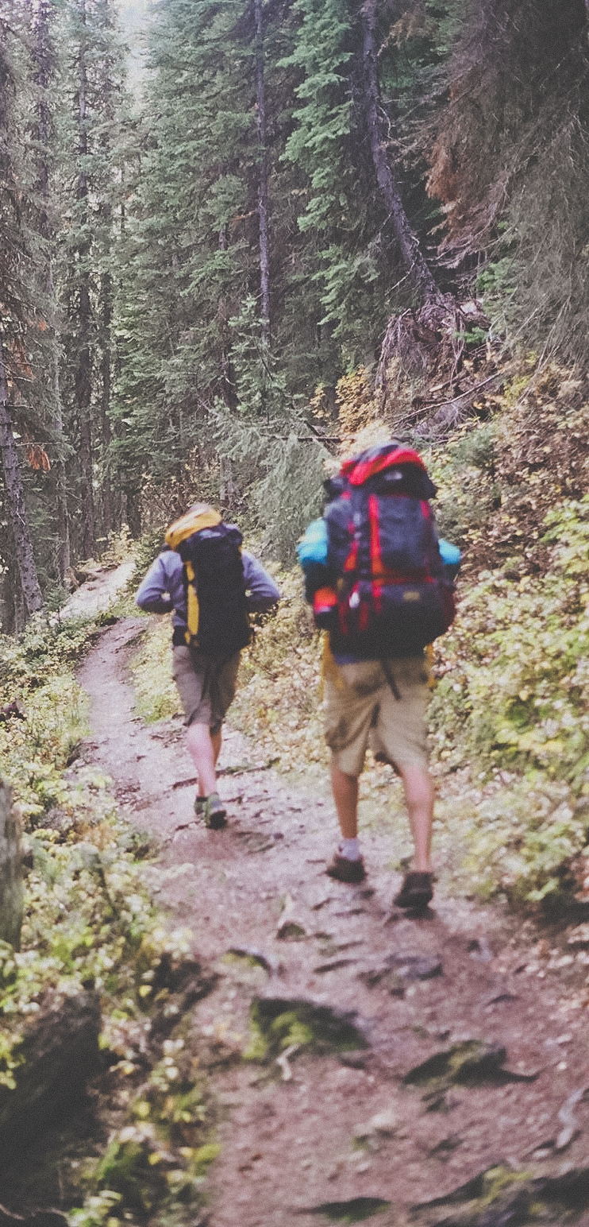

Analysis & Design
WiscoExplore
Concept: Zeph Marcus
Additional consulting: Group 1

Slide 2
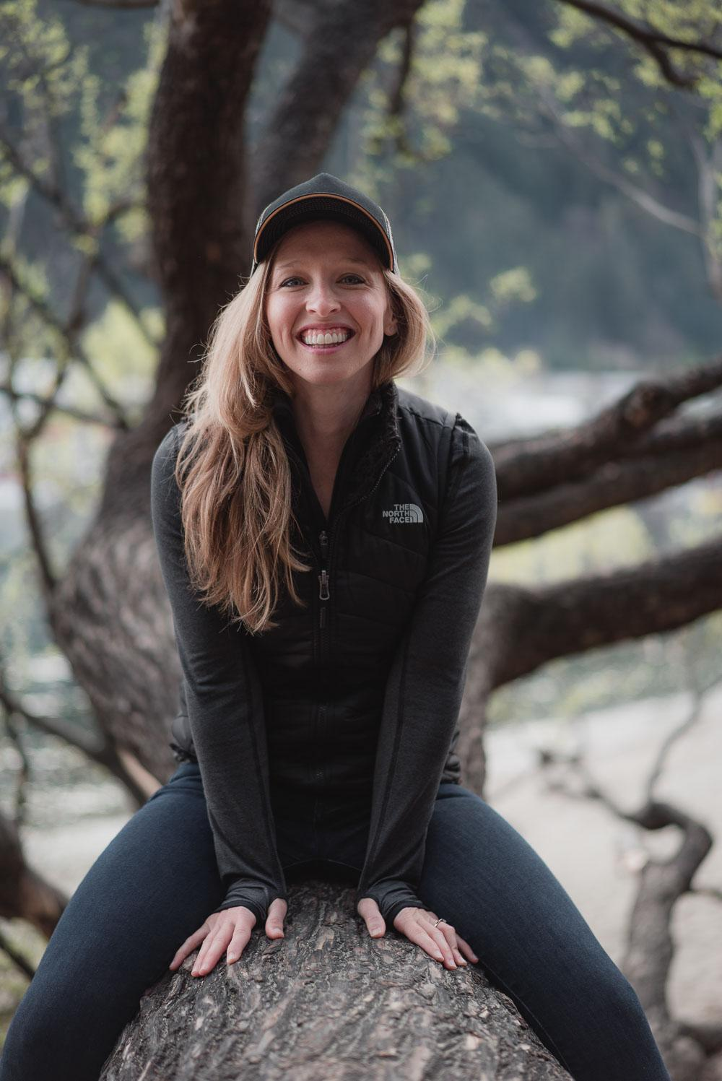
User Persona
Demographic
Age: 18-25 years old
Marital Status: Single
Occupation: Student
Expertise: Novice
Other: Pet-owner

Slide 3
User Persona
Goals:
Reserve campsite online.
Find list of campsite activities.
Upload photos from camping trip.
Motivations:
Take a break from daily routine.
Explore new places.
Develop camping skills.
Frustrations:
Ads – poor placement; too many.
Poor navigation.
Lack of clear information.

Slide 4
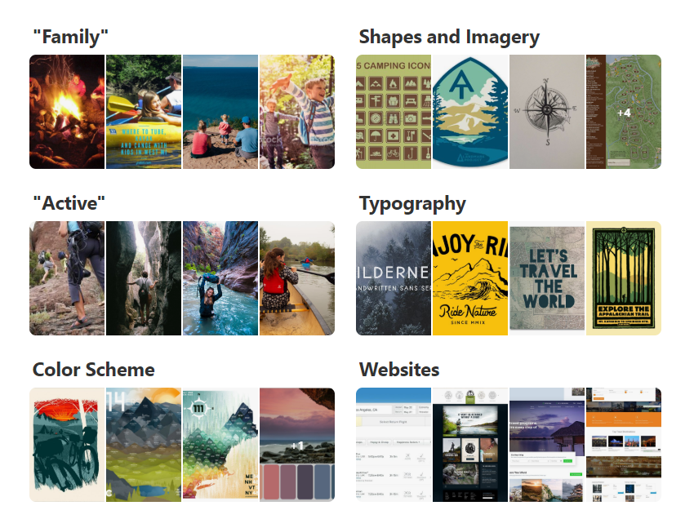
Mood Board
Link: https://www.pinterest.com/zcmarcus/camping/

Slide 5
Color Analysis

Slide 6
Color Analysis
User Needs
Crave new experiences.
Value clarity and conciseness.
Require smooth and easy nav
Green and Blue:
Tranquility and lushness of Wisconsin’s undisturbed natural spaces
Red and Grey(s):
Grounding quality of earth tones; draw comparison to rocky country hillsides; subdued hues provide structure without drawing user’s attention.
Light Blue:
Suggest clear open sky; provide contrast.

Slide 7
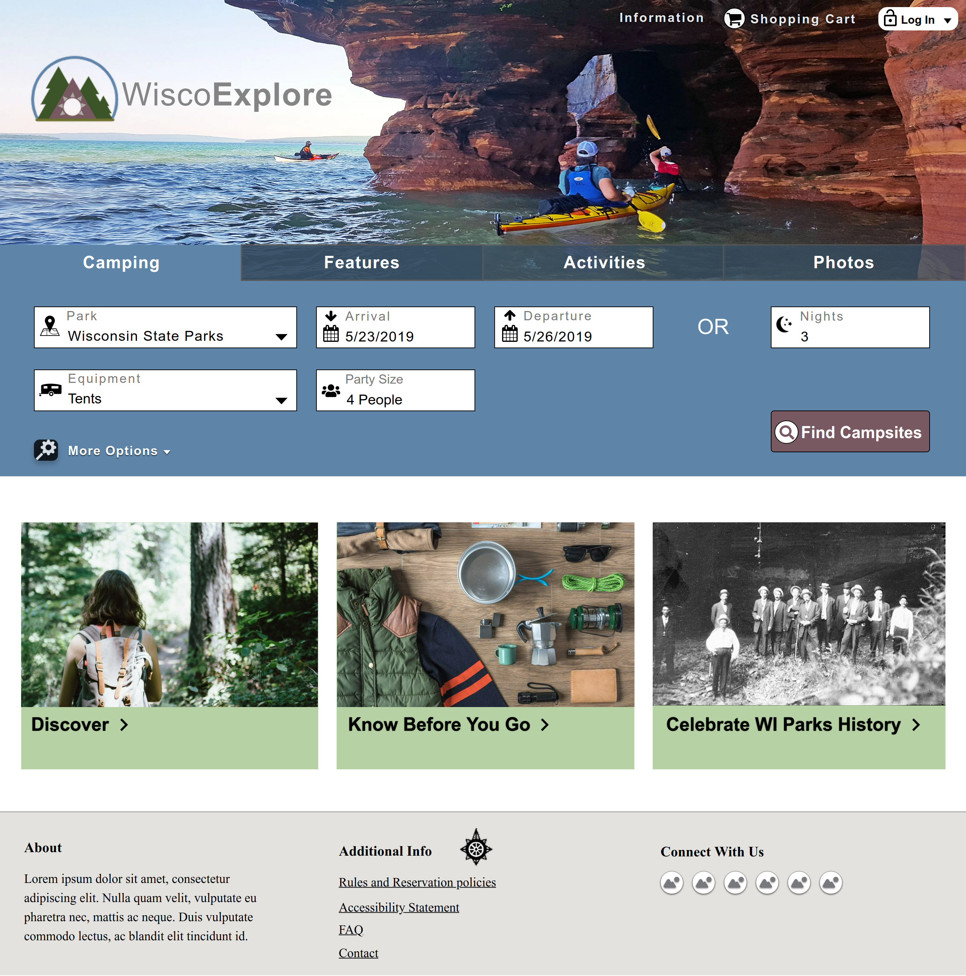
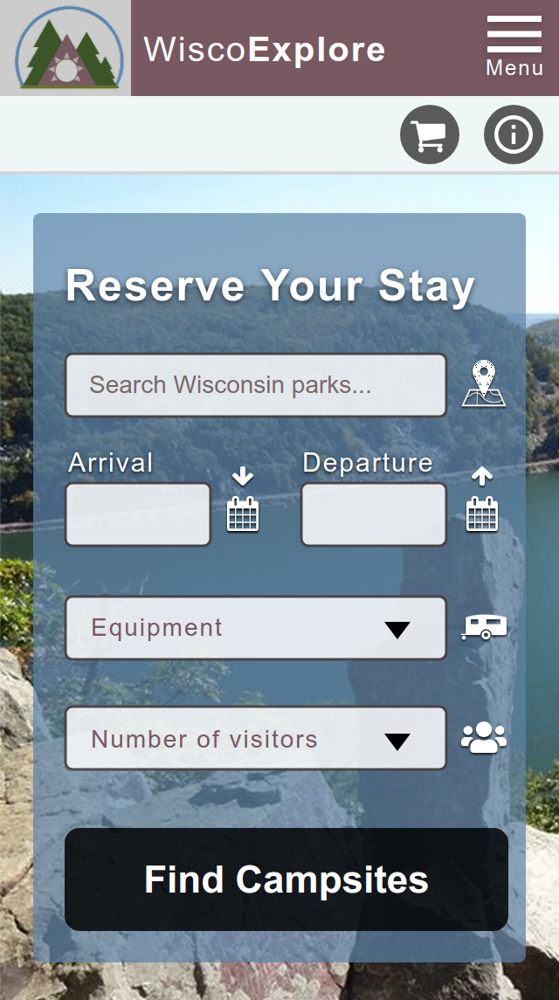
Website Experience
Ctrl-Click to view on Moqups.

